Slide 1
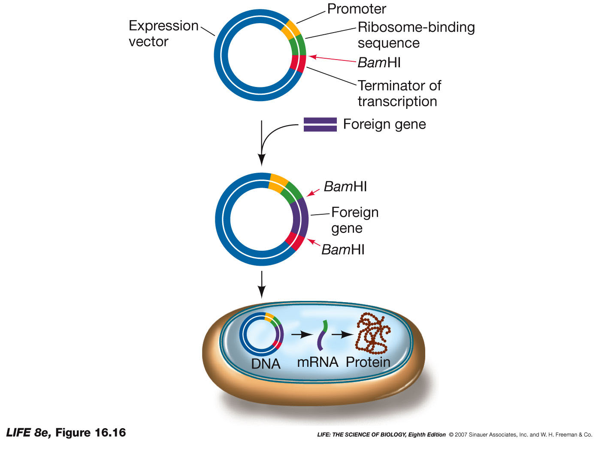
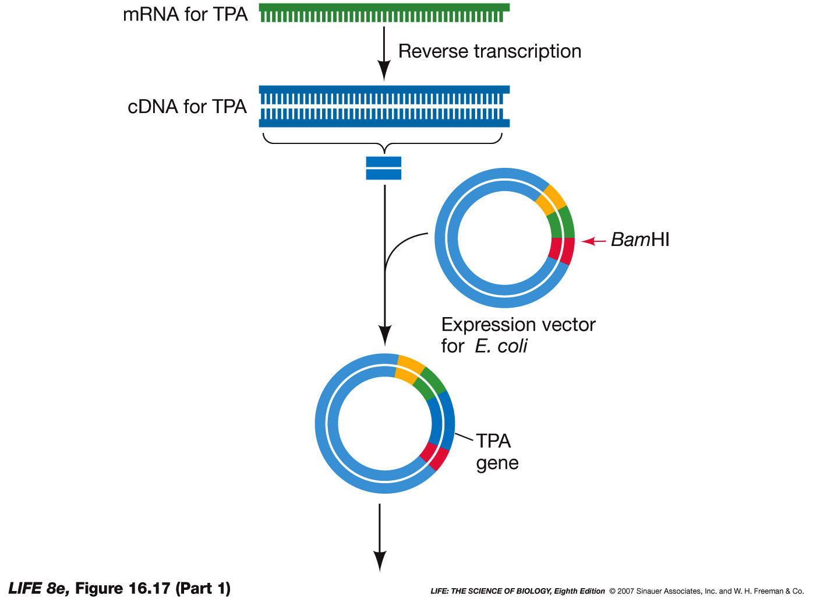
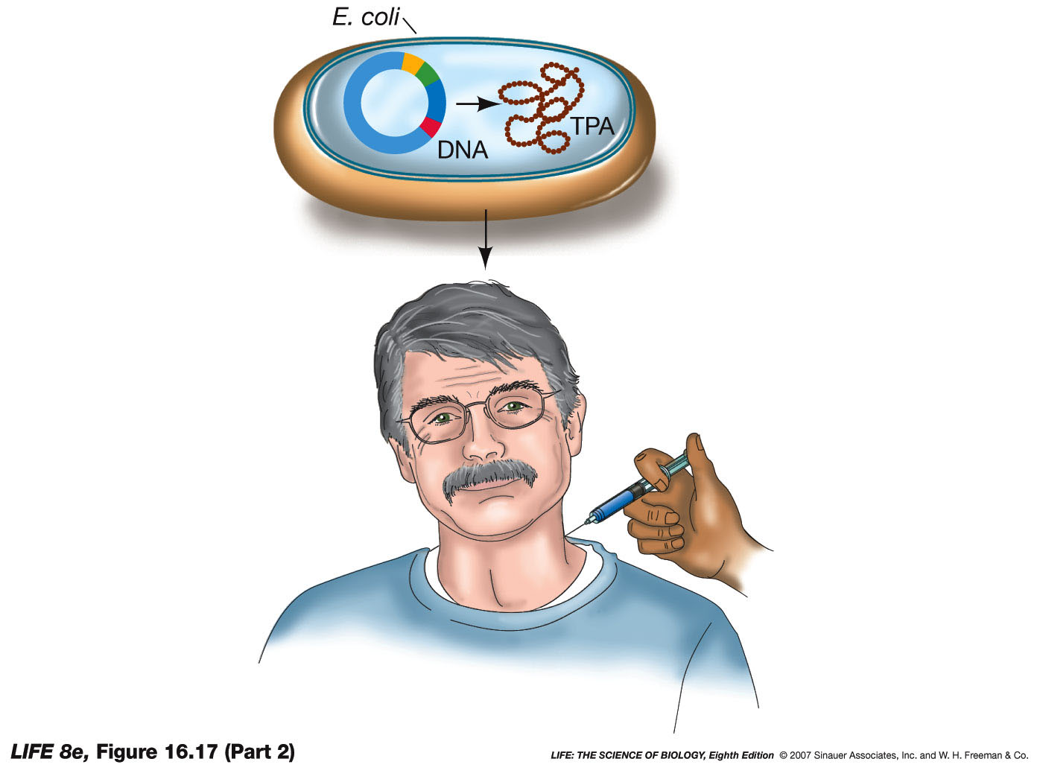
Intro to Biotech
Lect.9
What is problem – can Biotechnology help?
- recombinant DNA

Slide 2
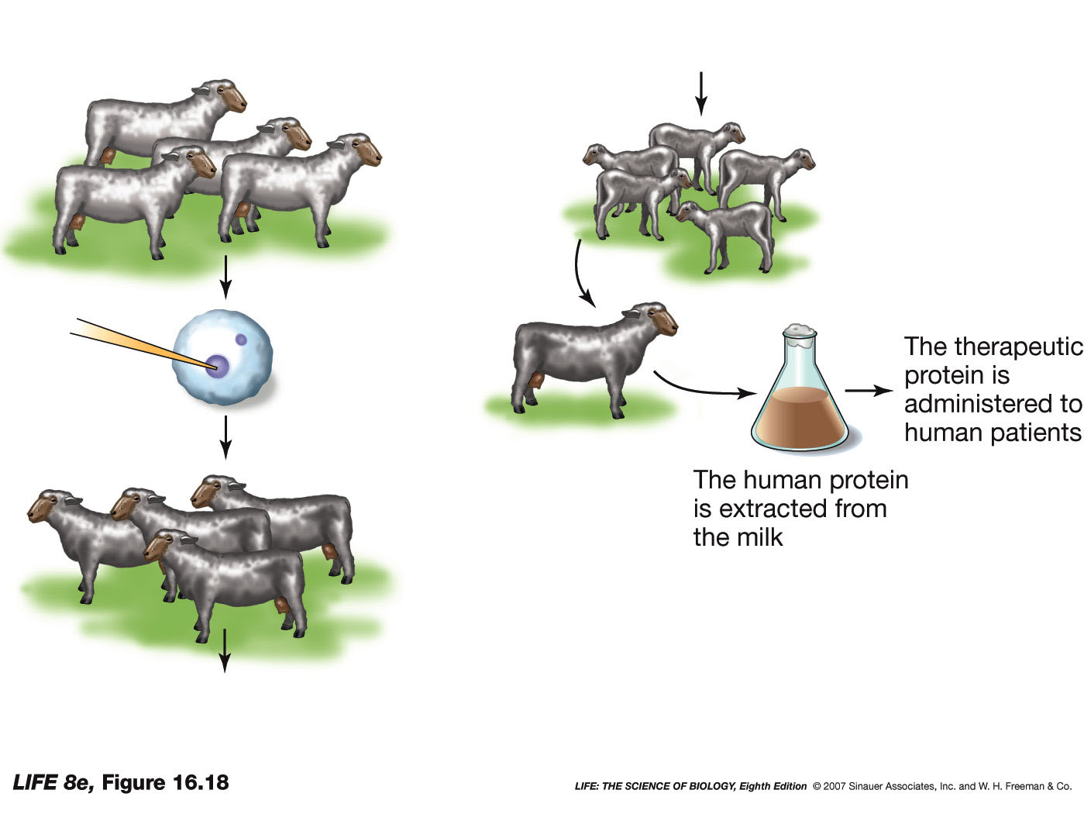
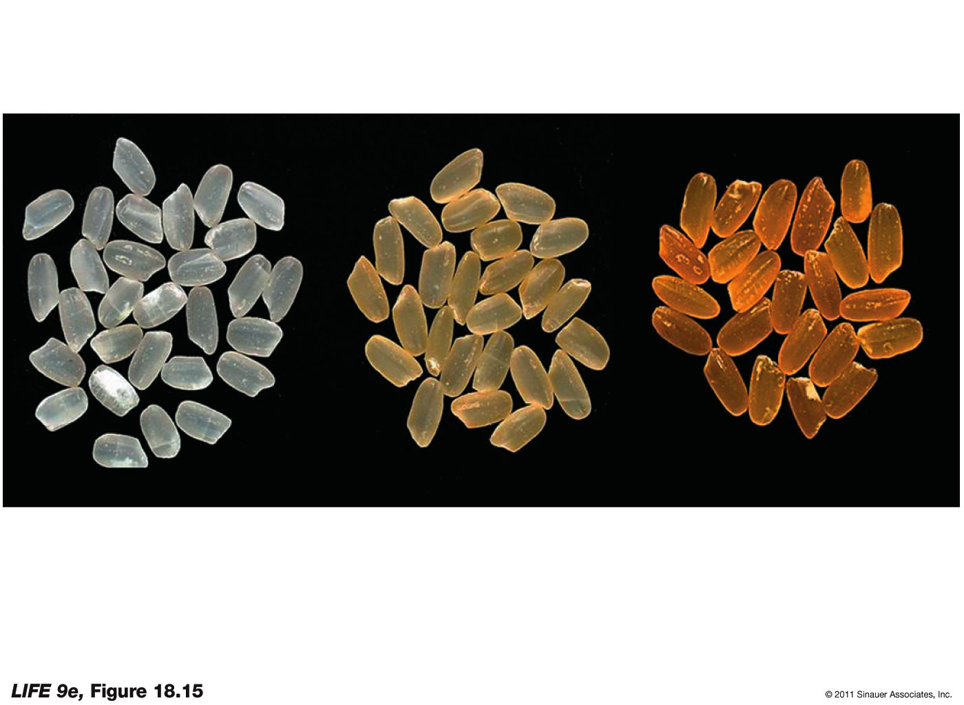
Intro to Biotech
Lect.9
What is problem – can Biotechnology help?
- recombinant DNA
Transgenics
Pharming
Lactoglobulin promoter?
•
•
•
•
Green Biotechnology

Slide 3
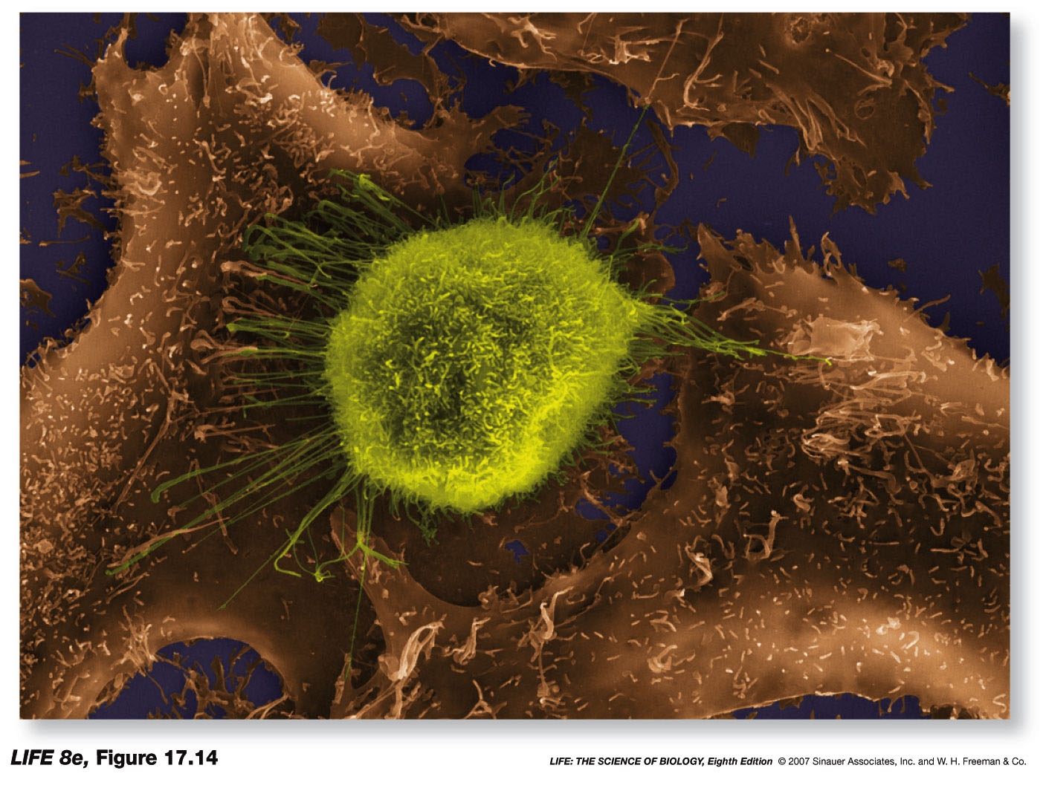
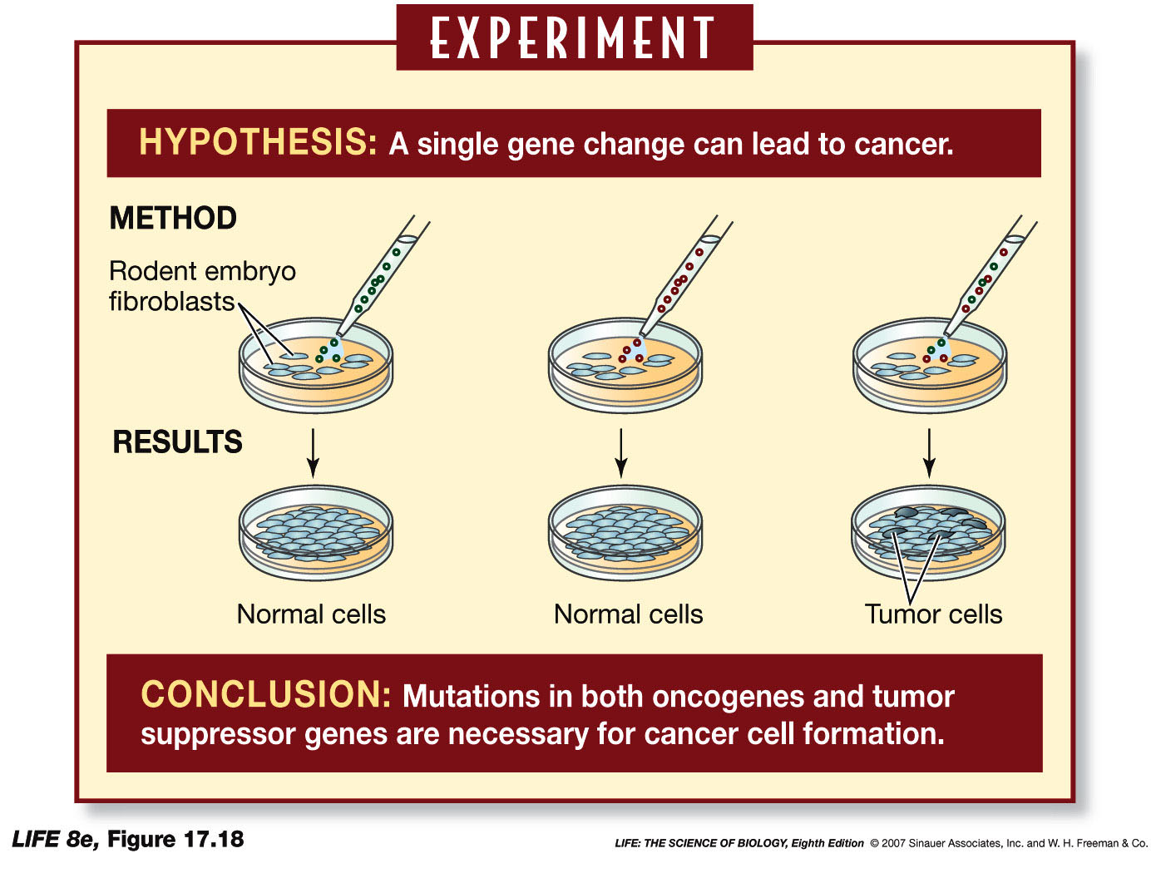
Intro to Biotech
Lect.10
What is problem – can Biotechnology help?
- Cancer
Molecular basis of diseases – cancer
a.
b. viral vs gene based (15% vs 85%)
c. oncogene vs tumor suppressors (gas pedal vs brake)
d.
Ras^{Act}
p53^{Dn}
Ras^{Act}
+
p53^{Dn}
oncogenic

Slide 4
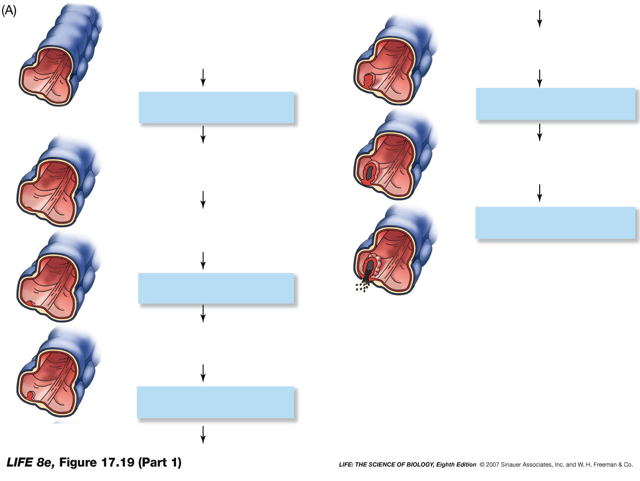
Intro to Biotech
Lect.10
What is problem – can Biotechnology help?
- recombinant DNA
Molecular basis of diseases – cancer
d.
Section through colon
(large intestine)
Normal cells
A class III adenoma
(benign) grows.
APC lost
p53 lost
A carcinoma (malignant
tumor) develops.
Polyp forms
Benign tumor
Additional changes
ras activation
A class II adenoma
(benign) grows.
DCC lost

Slide 5
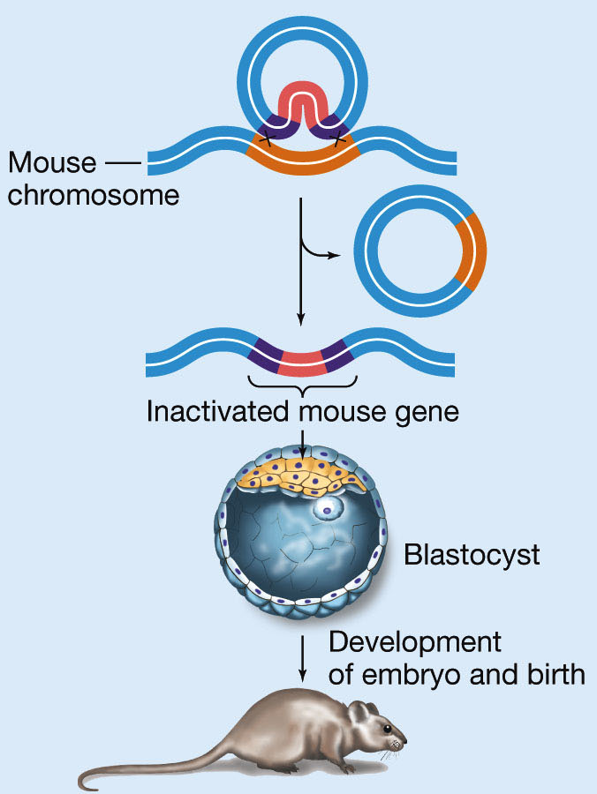
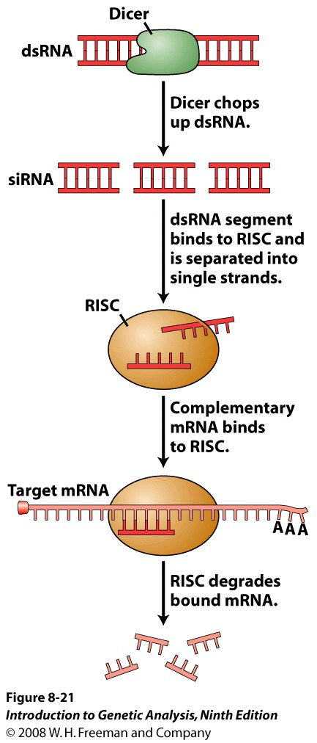
Intro to Biotech
Lect.10
What is problem – can Biotechnology help?
- recombinant DNA
Alter Gene Activity (LOF/GOF)
transgenics
knockdowns

Slide 6
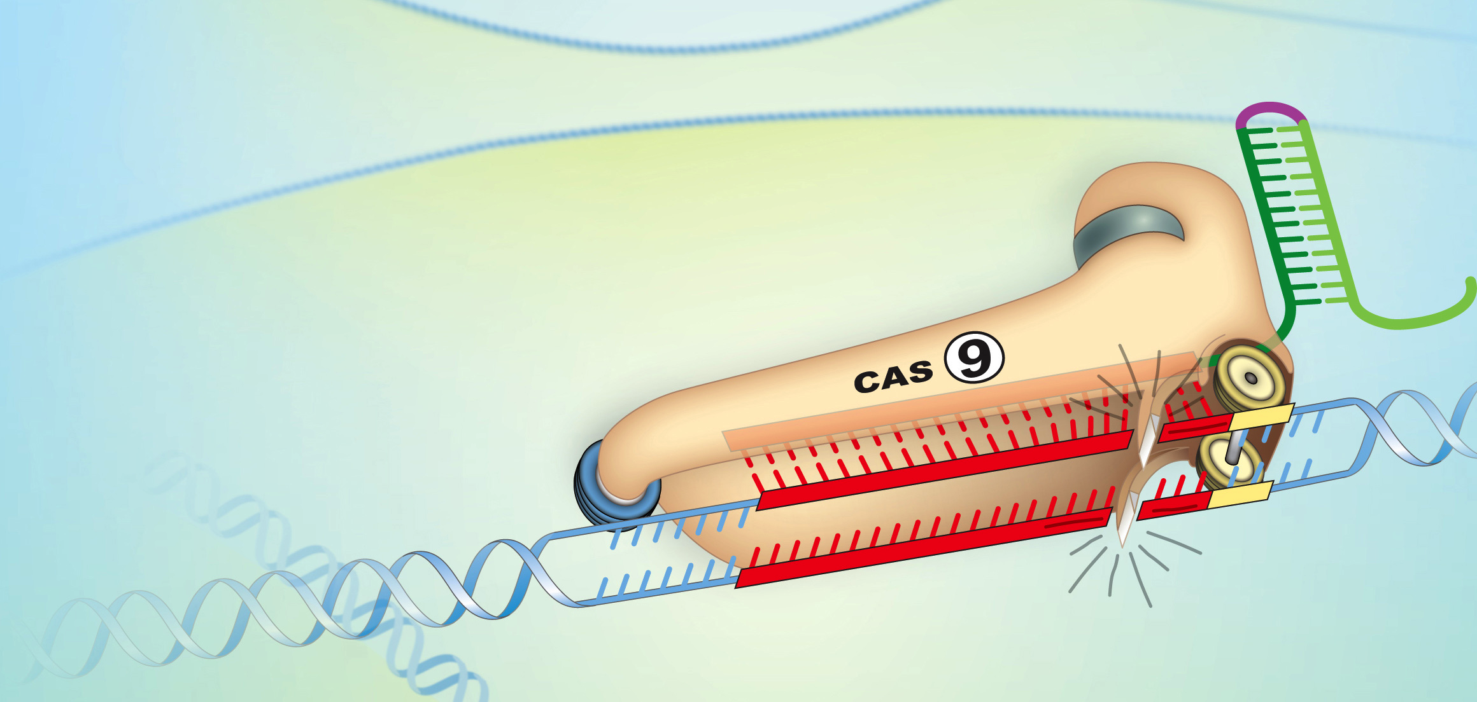
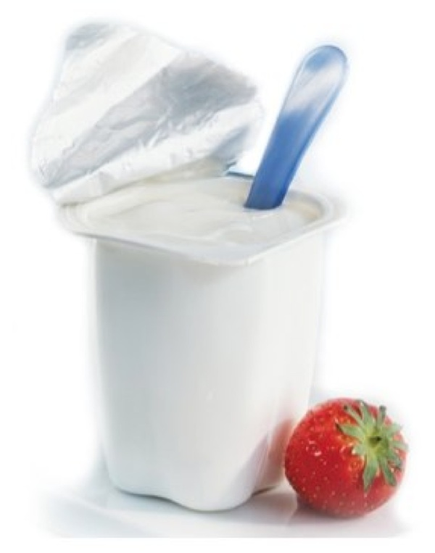
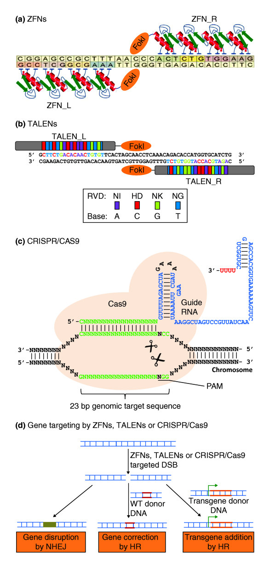
Intro to Biotech
Lect.10
Recombinant DNA – State of the Art
Genome Engineering
Strep. thermoph.

Slide 7
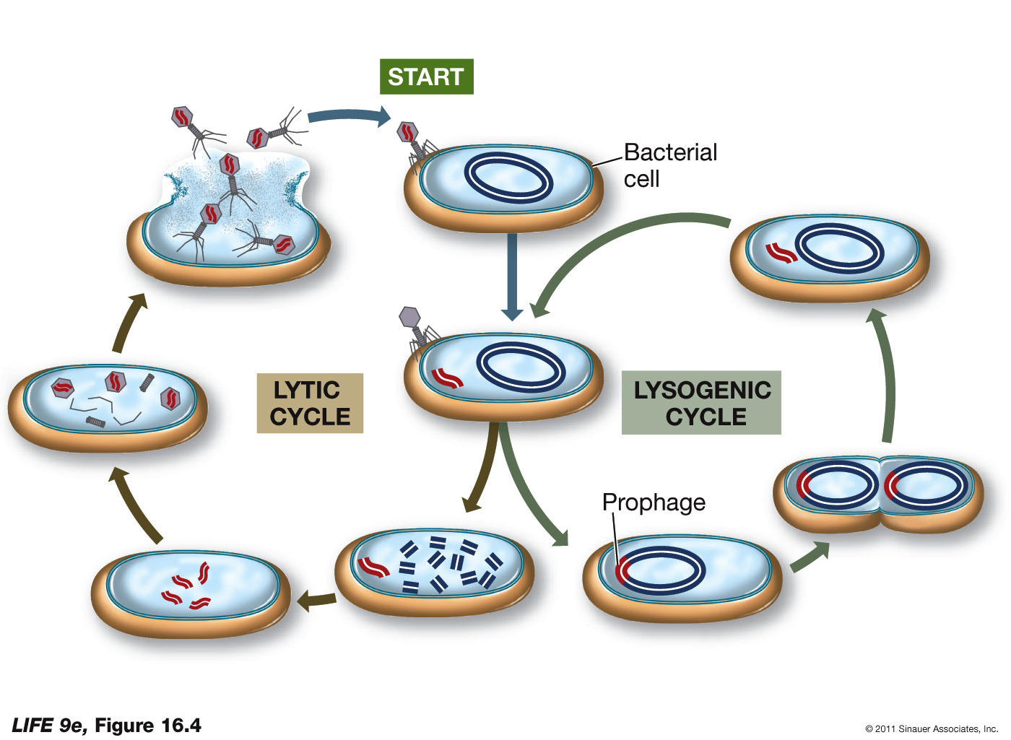
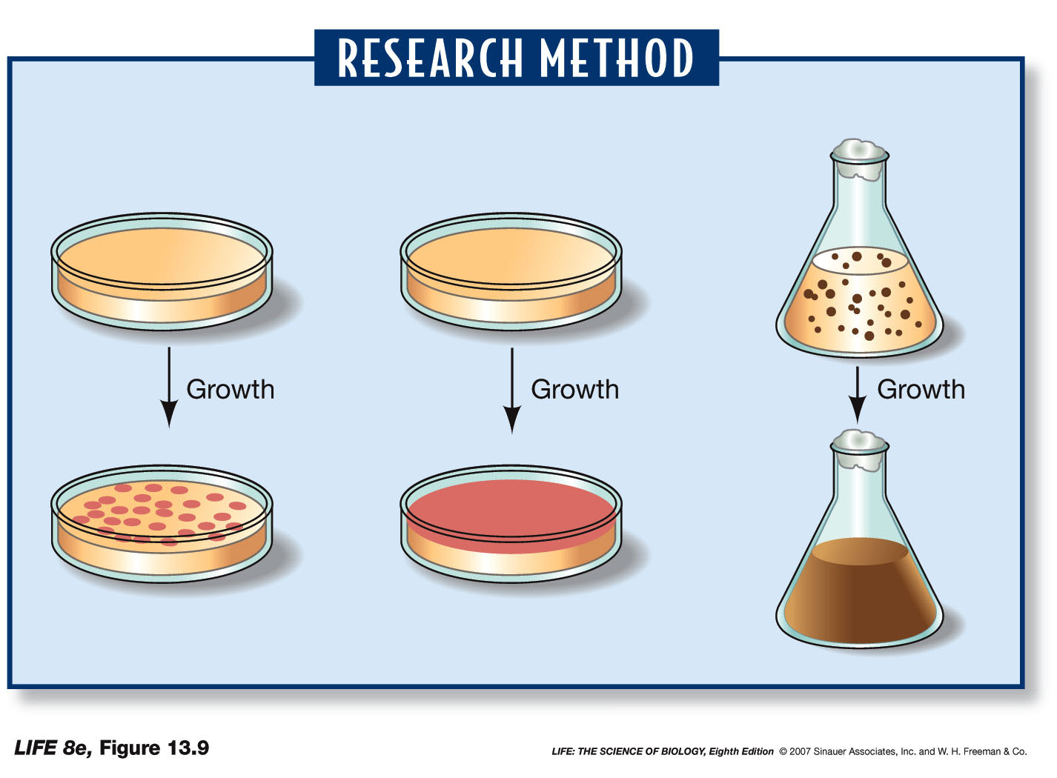
Intro to Biotech
Lect.10
Viruses, Prokaryotes, Eukaryotes
• Biotechnology systems?
Viruses:
-
-
-
-
Prokaryotes:
-
- haploid
- selection
-
- small genome
- ease of culture
- storage
-
functions
•
•
•

Slide 8
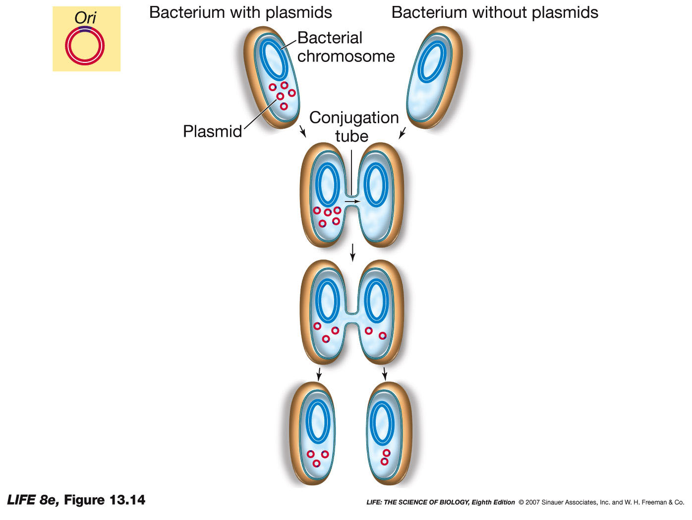
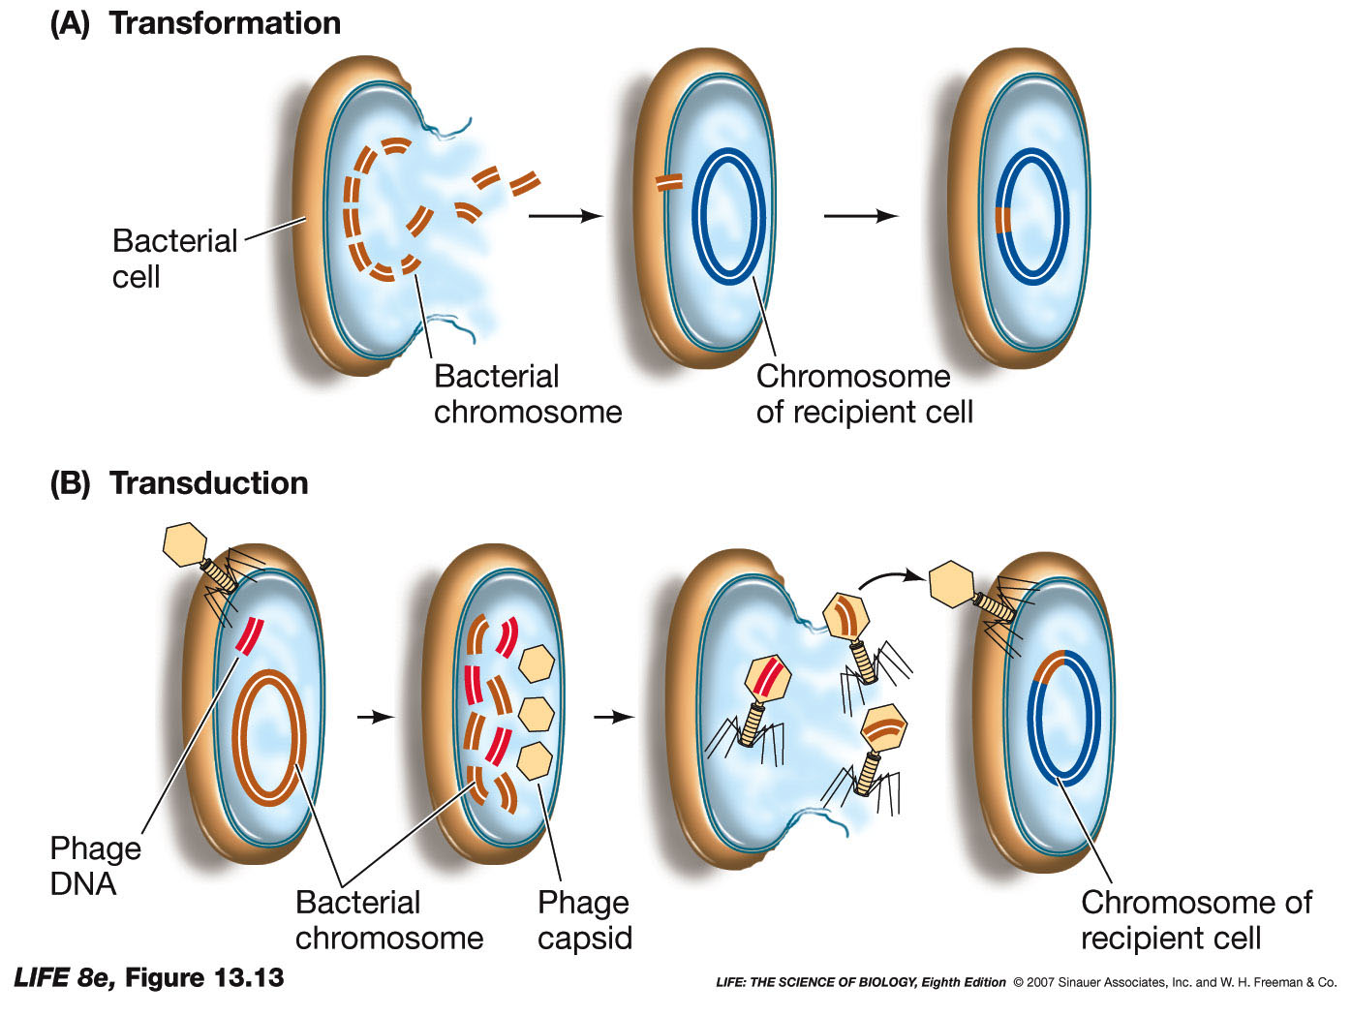
Intro to Biotech
Lect.10
Prokaryotes:
no meiosis
gene transfer
1. conjugation =
2. transformation =
3. transduction =
Conjugation -
Transformation
Possible uses in biotech??

